Slide 1
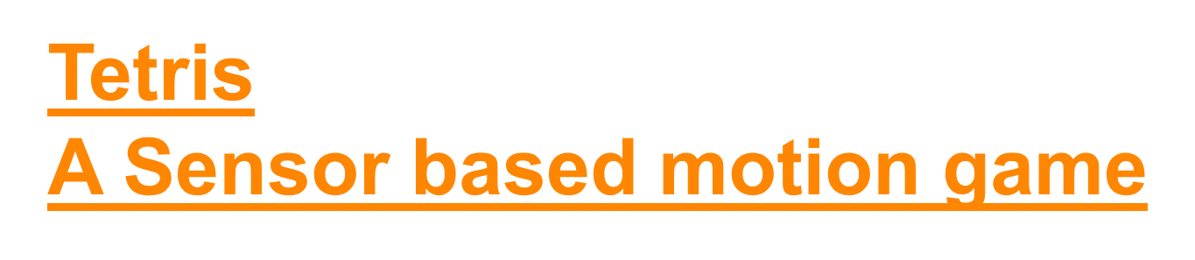
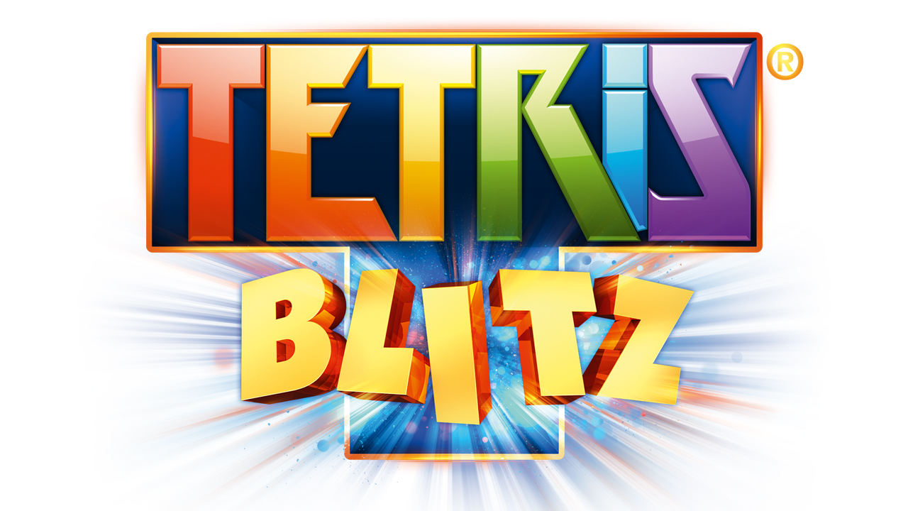
By
Ponnam Balakrishna
Kommineni Siva Krishna
Boyanapalli Swathi
Pathuri Savya Sri

Slide 2
Motivation/Objective:
Till now we are using /playing the games that don't have any physical control.
We developed a game with physical control for the best experience of users.
It is a native mobile app which is controlled by sensor tag.
Various motions can be detected and analyzed using machine learning technique.

Slide 3
System Architecture:

Slide 4
System Features:
We developed it from an open source project called Tetris.
Different motions are analyzed for activity recognition like left, right, rotate, down and punch actions.
Generated charts for the motions analyzed
Game is based on the blocks falling from the top and controlling them using sensor.
Data is stored in HBase in a column oriented approach.

Slide 5
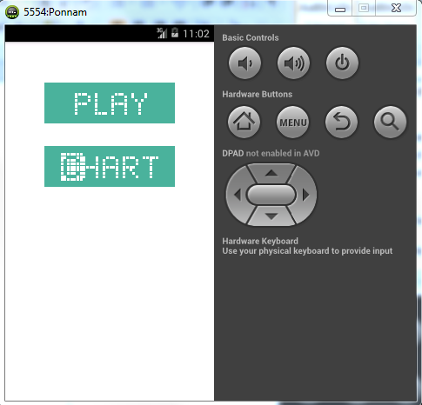
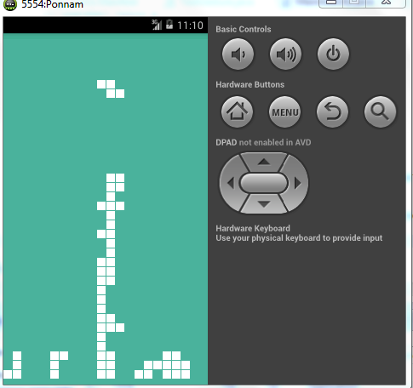
Online Game:
Game UI and main screens

Slide 6
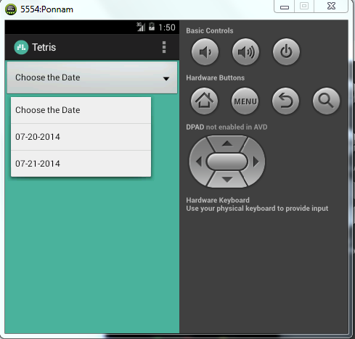
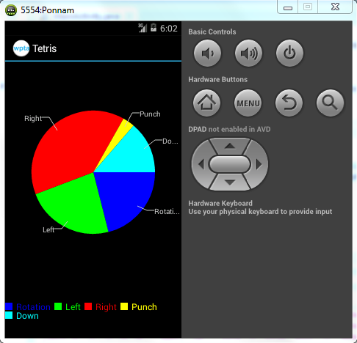
Activity Report:
Report for the data collected during playing game.

Slide 7
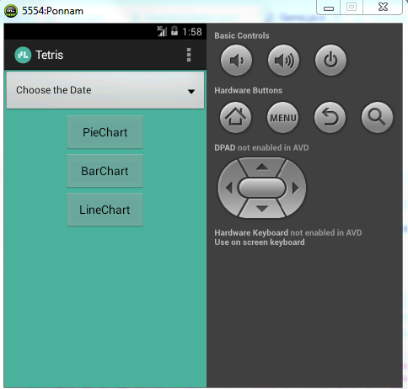
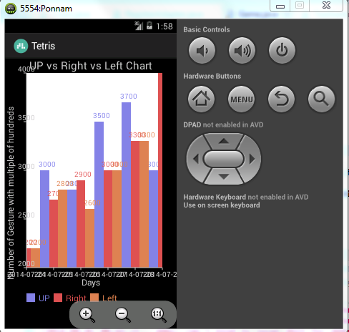
Graphs:
Analytics using Bar chart.

Slide 8
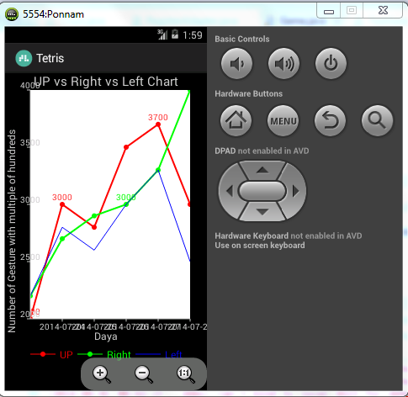
Line chart:
Chart analysis using collected data.

Slide 9
Evaluation:
Data is collected using the sensor tag and analyzed for different types of gestures and motions.
Trained approximately 50 samples for the different gestures
These samples are trained using HMM and K-Means clustering algorithm and sequence files are generated.
The trained samples are later tested for performance evaluation

Slide 10
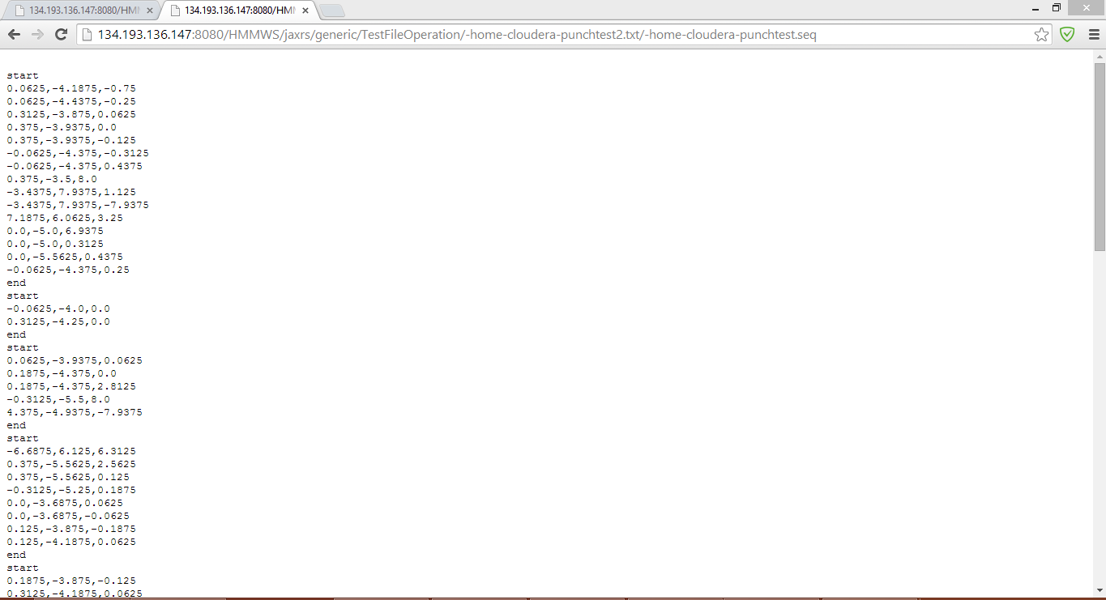
Training data:

Slide 11
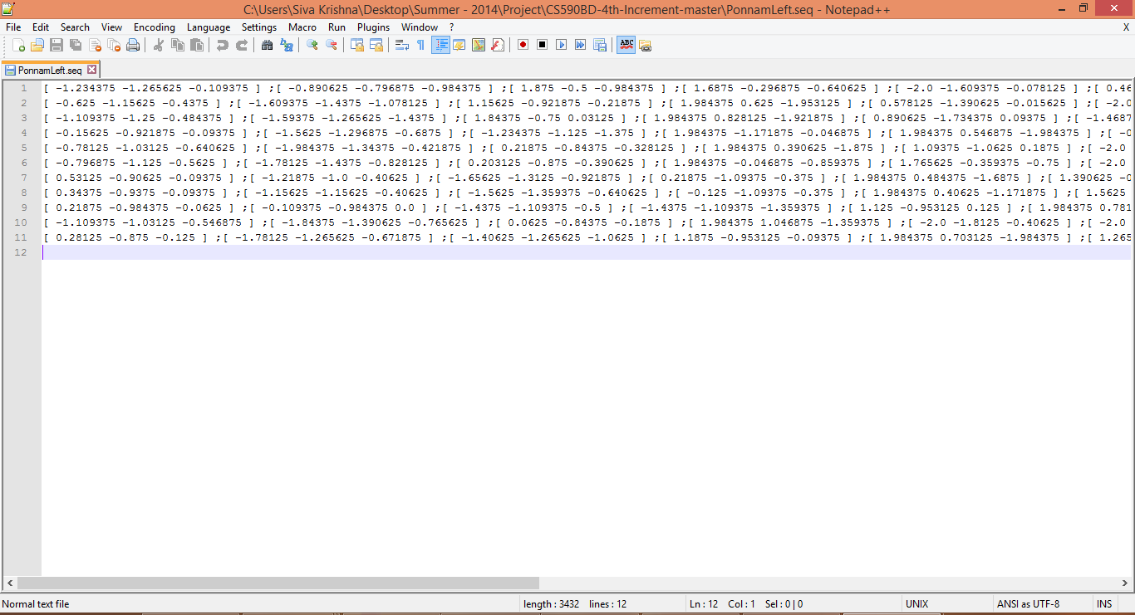
Sequence Files:

Slide 12
Predicted
Activity | Left | Right | Punch | Down | Rotate
Left | 41 | 2 | 0 | 0 | 0
Right | 5 | 45 | 0 | 0 | 0
Punch | 0 | 0 | 50 | 0 | 0
Down | 0 | 0 | 2 | 40 | 8
Rotate | 0 | 0 | 0 | 2 | 48

Slide 13
Calculations
Activity | Precision=TP/TP+FP | Recall=TP/TP+FN | F=2*P*R/P+R
Left | 41/41+5 =0.8913 | 41/41+9 =0.82 | 1.4617/1.7113 =0.8541
Right | 45/45+2 =0.91 | 45/45+10 =0.90 | 1.722/1.65 =0.912
Punch | 50/52 =0.9615 | 50/53 =0.961 | 1.92/1.94 =0.9604
Down | 40/42 =0.954 | 40/50 =0.80 | 1.523/1.752 =0.8694
Rotate | 48/48+7 =0.7619 | 48/50 =0.96 | 1.4628/1.7219 =0.8495

Slide 14
Limitations:
The application is taking some time in the initial phase to get trained.
It does not support upward direction movement.
It takes large amount of time to complete the game.

Slide 15
P.S
This work was done in partial fulfillment of the requirements of :
CS590BD: Big Data Analytics and Applications,
CSEE Department, University of Missouri – Kansas City (Summer 2014).
Instructor: Dr. Yugyung Lee
TA: Feichen Shen.

